Slide 1
Direct File Transfer System via WebRTC
An Alternative to E-mail Attachments with Improved Security
Robin Lunde
Mobile And Ubiquitous Internet
Main advisor: Keiji Takeda
Co-advisors: Jun Murai Osamu Nakamura

Slide 2
Introduction

Slide 3

Key points
Developed a prototype – SendIt
Secure, (Serverless,) Electron & NodeJS-based, Direct Information Transfer
Simple, user-friendly system
Complimentary
Not a replacement
Usable, improved security!
Absolutely security not the goal
Notes:
Acronym!
Complimentary – to e-mail attachments

Slide 4

Use cases
Secure file transfer
Setup in person
Slightly inconvenient
Security comparable to PGP
Easy way to transfer files
Setup over internet
Convenient
Reasonably secure
Compliant with new regulations
Privacy & Data control
GDPR (EU) / SP 800-171 (US/World)
Direct transfer – No storage in transit

Slide 5

Trust & Authentication
Non-absolute authentication:
Timing
Files offered
Sender
Used for first interaction only!
First time communicating
Share keys
Authentication dependant on first trust:
Done in person – Best!
Notes:
Intuitive approach to authentication

Slide 6
Goals & Contributions
Goals
Work
Contributions

Slide 7
Goals
Improve security and ease of use for e-mail attachments
Minimize risk of leakage and exposure of personal data
Create a system with focus on usability, privacy and security
Create a prototype to show feasibility

Slide 8

Contributions
New type of system
Client-only development
New perspective on e-mail attachments
Security to the people
Serverless implementation
Decentralized internet
Notes:
System: The exchange and management of identities combined with peer-to-peer transfer and trust evaluation.

Slide 9

Concepts & Design

Slide 10

Trust system
Not suitable to use PKI
Requires setup
Non-absolute authentication
Used for first interaction only!
Based on Web of Trust
Utilizes Public-key cryptography, like PGP
Trust transitivity*
Gradual trust building*
Negative > Positive
Trust re-evaluated constantly*
*Not implemented but framework designed.
Notes:
Timing
Files offered
Sender

Slide 11
Authentication
Public-key cryptography
Identity represented by e-mail
Authentication and connection setup combined
Usually separate processes
WebRTC Offer & Answer
Includes endpoint authentication
Keys shared:
Over P2P channel
Encrypted
During first connection
Depends on first connection:
In person – More secure (Highest level of security in SendIt)
Open channel – Less secure
Notes:
Each identity is represented by an e-mail address (to be unique!)

Slide 12

Implementation

Slide 13



Technology
System is built using:
NodeJS
Electron
WebRTC
Experimental technology!
Enables easy development:
Desktop applications
Multi-platform support
Built-in NAT traversal
P2P communication
No server requirements

Slide 14
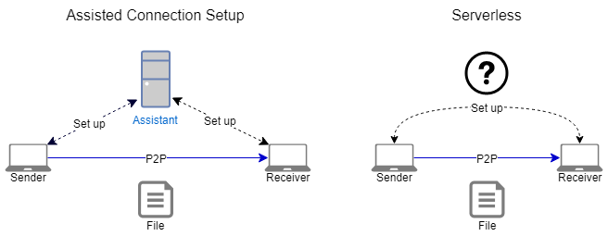
Modes
The modes only differ in how the connection information is shared
Automatic sharing:
Easier to use – less secure
Manual Sharing:
Harder to use – more secure

Slide 15
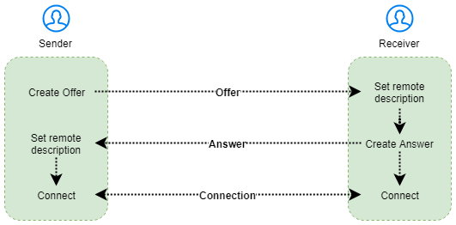
Usability evaluation
Only Serverless mode
WebRTC connection setup
Experimental!
Experiment
Simulating user behaviour
Total setup time:
Around 6 minutes
Offer last longer than Answer
Notes:
Only affects Serverless mode
Is a consequence of how the WebRTC connection setup is done
Experimental technology!!!
Simulating user behaviour by adding delay to the WebRTC connection setup
Twice, to confirm findings
Setup time 6 min
Offer has longer lifetime than Answer.

Slide 16
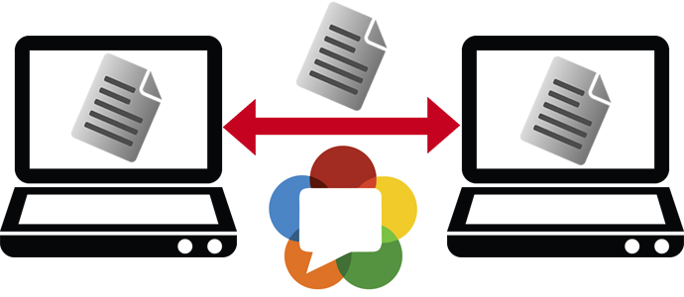
Transfer speed & efficiency
Same as popular P2P systems
Depends on network conditions
Works on any network
Except Symmetrical NAT
Optimal = LAN
Test transfer WIDE -> Yamato:
40 Megabytes transferred
Completed: 34 Seconds
Speed > 10Mbyte/s!
WIDE – Dl: 1000 Mbit/s, Ul: 735 Mbit/s
Yamato – DL: 85Mbit/s, Ul: 10Mbit/s
Notes:
Bottom right, measuremed bandwidth for the two locations/endpoints

Slide 17

Demonstrations

Slide 18
ACS Demo

Slide 19
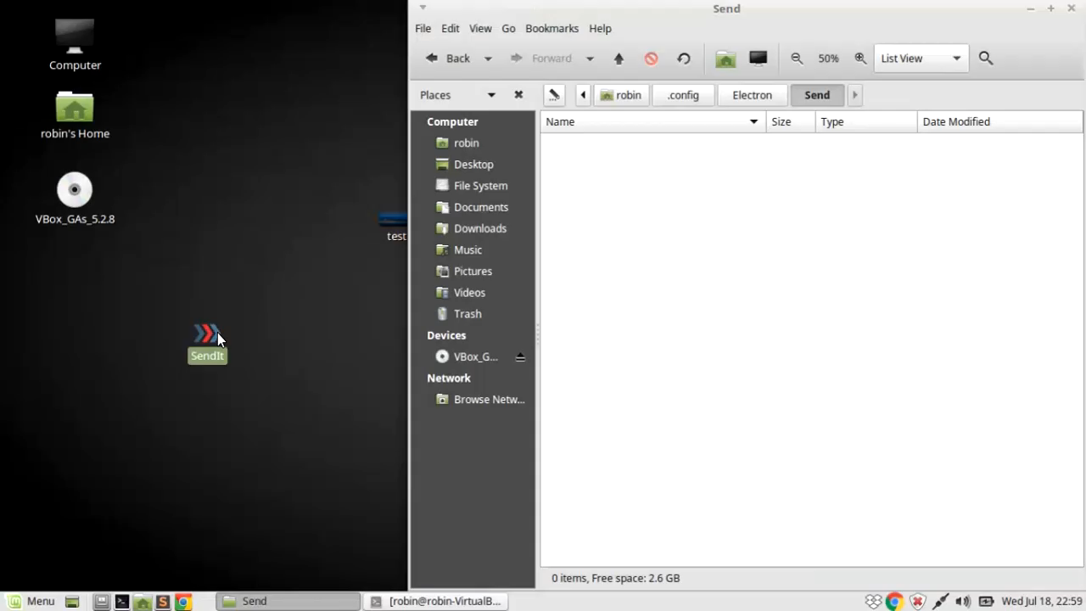
Notes:
ACS

Slide 20
Serverless Demo

Slide 21
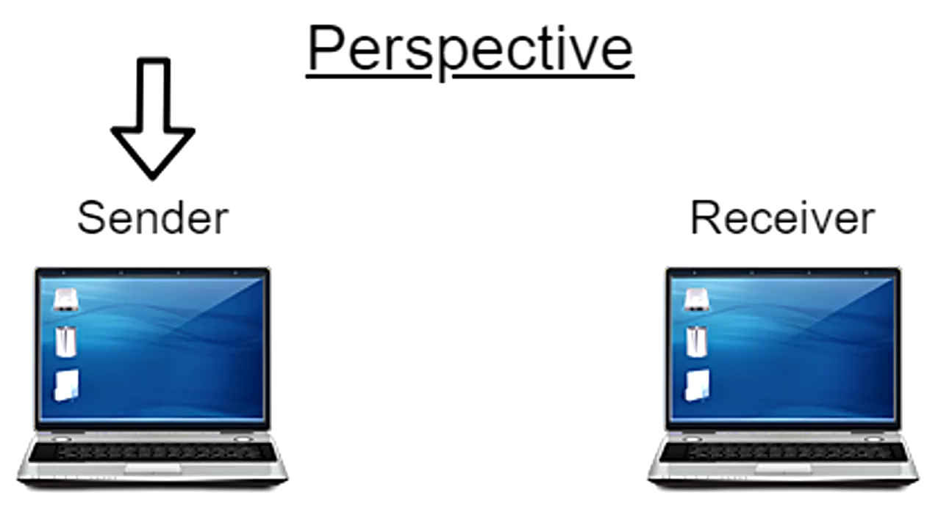
Notes:
Serverless

Slide 22

Evaluation & Comparison

Slide 23
Evaluation
Comparison based:
E-mail
Cloud- and SNS
E-mail offers no guarantee of any security features
Anything is an improvement
File storage in Cloud- and SNS-based systems:
Large attack surface
Low content control
SendIt’s main weakness:
First trust abuse

Slide 24
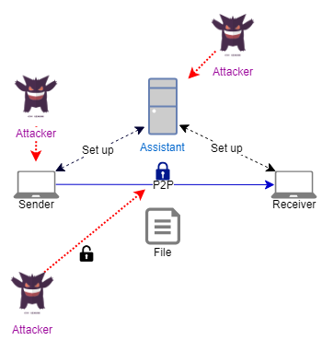
SendIt threat evaluation
Authenticate with false identity (First exchange)
Key theft
XSS
Malicious Assisted Connection Setup
Break encryption
Compromise Sender’s computer
Notes:
ACS:
MITM
Logging
Wrong relay (No real impact)

Slide 25
Comparison
Synchronous
Must be online simultaniously
First connection is trusted
Requires connection setup
No multicast support
Low attack surface
Direct transfer
Easy to use
Simple system
Reasonably secure
Content control
Authentication
Notes:
Comparison to server-based systems
Intuitive
Content control: can stop transfer

Slide 26
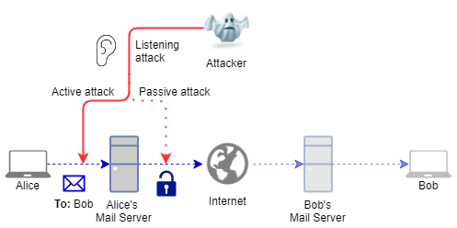
E-mail threat 1
Notes:
Passive: Unencrypted data from server
Active:
Get encrypted traffic passively, then actively try to break encryption

Slide 27
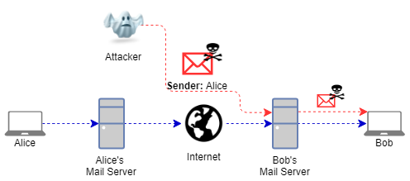
E-mail threat 2
Notes:
Impersonate

Slide 28
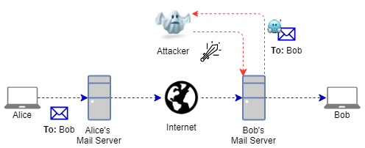
E-mail threat 3
Notes:
Reroute:
Only to himself OR copy to Bob and himself

Slide 29

E-mail attachment issues
Automatic spreading
No way of stopping file
No integrity guarantee
Stored multiple locations
Server
PC
Hard to notice
Impersonation
Hidden
Common attack vector
Notes:
Automatic forwarding – multicast
No content control
Clicked at later time
No way to guarantee file is not altered in transit
Sent from impersonated e-mail
Hidden:
-inside legitimate file
-Macro in office-doc

Slide 30
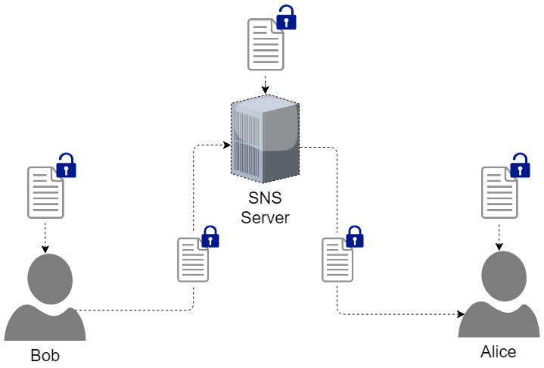
False end-to-end encryption
Notes:
SNS/Cloud
Skype!
Separate encryption for Sender & Receiver.
Stored unencrypted OR server stores decryption keys

Slide 31
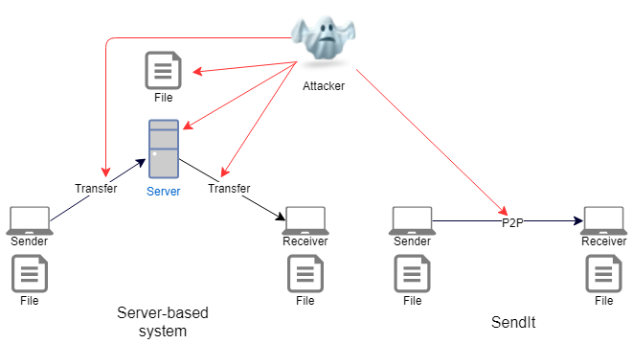
Threat comparison
Notes:
Attack communication between nodes and server.
If account is compromised, access to all files stored
If using false E2E encryption, hacking server -> all files on server
Even if encrypted, question of time!
SendIt:
P2P channel only

Slide 32

Conclusion

Slide 33
Created a prototype (SendIt)
Alternative to e-mail attachments
Decentralized system
Serverless
Improvement to current e-mail system
Goals achieved:
Create a prototype to show feasibility.

Slide 34
Reduced attack surface
Endpoint authentication
Based on first trust
End-to-end encryption
Direct communication
No temporary storage
Continous trust evaluation
Goals achieved:
Improve security and ease of use for e-mail attachments.
Create a system with focus on usability, privacy and security.
Minimize risk of leakage and exposure of personal data.

Slide 35
Easy to use
Automatic:
Key management
Trust system
Authentication
No setup or sign-up required
Goals achieved:
Improve security and ease of use for e-mail attachments.
Create a system with focus on usability, privacy and security.

Slide 36

System Limitations
First trust
Synchronous
Connection setup
Notes:
Non absolute authentication
Both online
Every time!

Slide 37
Simple system focused on security
Improves security and ease of use for e-mail attachments!

Slide 38
References

Slide 39
“About Electron | Electron.” Accessed March 26, 2018. /docs/tutorial/about.
Alfarez, Abdul-Rahman. “The PGP Trust Model - Semantic Scholar.” Accessed March 26, 2018. /paper/The-PGP-Trust-Model-Abdul-Rahman/e9aa5d8032c1d925ea6a02dd3be93f42e831c965.
Ball, Chris. Serverless-Webrtc: A Demo of Using WebRTC with No Signaling Server. JavaScript, 2018. https://github.com/cjb/serverless-webrtc.
Bergkvist, Adam, Daniel C. Burnett, Cullen Jennings, Anant Narayanan, Bernard Aboba, and Taylor Brandstetter. “WebRTC 1.0: Real-Time Communication Between Browsers.” Accessed March 26, 2018. https://www.w3.org/TR/webrtc/.
Camarillo, Gonzalo, Oscar Novo, and Simon Perreault. “Traversal Using Relays around NAT (TURN) Extension for IPv6.” Accessed March 26, 2018. https://tools.ietf.org/html/rfc6156.
“Chrome | WebRTC.” Accessed March 26, 2018. https://webrtc.org/web-apis/chrome/.
“Chrome V8.” Google Developers. Accessed March 26, 2018. https://developers.google.com/v8/.
contributors, Mark Otto, Jacob Thornton, and Bootstrap. “Bootstrap.” Accessed March 26, 2018. https://getbootstrap.com/.
Zimmermann, Philip R. The Official PGP User’s Guide. Cambridge, MA, USA: MIT Press, 1995.
39

Slide 40
Douceur, John R. “The Sybil Attack.” In Peer-to-Peer Systems, 251–60. Lecture Notes in Computer Science. Springer, Berlin, Heidelberg, 2002. https://doi.org/10.1007/3-540-45748-8_24.
“Firefox Test Pilot - Send.” Accessed March 24, 2018. https://testpilot.firefox.com/experiments/send/.
Handley, Mark, Colin Perkins, and Van Jacobson. “SDP: Session Description Protocol.” Accessed March 26, 2018. https://tools.ietf.org/html/rfc4566.
Holmberg, Hans-Christer. “Web Real-Time Data Transport.” Helsinki Metropolia University of Applied Sciences, 2015. https://www.theseus.fi/bitstream/handle/10024/94759/FinalThesis_hanschrh_final.pdf?sequence=1&isAllowed=y.
“How PGP Works.” Introduction to Cryptography, 1999 1990. https://users.ece.cmu.edu/~adrian/630-f04/PGP-intro.html.
“I2P-Bote.” Accessed March 24, 2018. https://i2pbote.xyz/.
“I2P-Bote Introduction and Tutorial | Darknet Email.” The Tin Hat. Accessed March 24, 2018. https://thetinhat.com/tutorials/messaging/i2pbote.html.
WHITTEN, ALMA, and J D TYGAR. “A Usability Evaluation of PGP 5.0,” n.d., 24. https://people.eecs.berkeley.edu/~tygar/papers/Why_Johnny_Cant_Encrypt/OReilly.pdf.
40

Slide 41
Ibáñez, L. D., E. Simperl, F. Gandon, and H. Story. “Redecentralizing the Web with Distributed Ledgers.” IEEE Intelligent Systems 32, no. 1 (January 2017): 92–95. https://doi.org/10.1109/MIS.2017.18.
“Index | Node.Js v7.10.1 Documentation.” Accessed March 26, 2018. https://nodejs.org/docs/latest-v7.x/api/.
Ivov, Emil, Peter Saint-Andre, Eric Rescorla, and Justin Uberti. “Trickle ICE: Incremental Provisioning of Candidates for the Interactive Connectivity Establishment (ICE) Protocol.” Accessed March 26, 2018. https://tools.ietf.org/html/draft-ietf-ice-trickle-17.
Jesup, Randell, and Salvatore Loreto. “WebRTC Data Channels.” Accessed March 26, 2018. https://tools.ietf.org/html/draft-ietf-rtcweb-data-channel-13.
Jøsang, Audun, Roslan Ismail, and Colin Boyd. “A Survey of Trust and Reputation Systems for Online Service Provision.” Decision Support Systems 43, no. 2 (March 2007): 618–44. https://doi.org/10.1016/j.dss.2005.05.019.
Jøsang, Audun, and Simon Pope. “Semantic Constraints for Trust Transitivity.” Second Asia-Pacific Conference on Conceptual Modelling (APCCM2005 Vol. 43 (n.d.): 10.
Watson, Mark. “Web Cryptography API.” Accessed March 26, 2018. https://www.w3.org/TR/WebCryptoAPI/.
jquery.org, jQuery Foundation-. “JQuery.” Accessed March 26, 2018. https://jquery.com/.
41

Slide 42
Kiesel, Joseph. “GDPR Compliance: Summary & Requirements You Need to Know.” Linford & Company LLP (blog), July 5, 2017. https://linfordco.com/blog/gdpr-compliance-requirements/.
Kimmett, Taylor. Rtc-Pubnub-Fileshare: A File Sharing Demo Built Using PubNub and WebRTC. CSS, 2016. https://github.com/tskimmett/rtc-pubnub-fileshare.
Li, Li, Wu Chou, Zhihong Qiu, and Tao Cai. “Who Is Calling Which Page on the Web?” IEEE Internet Computing 18, no. 6 (November 2014): 26–33. https://doi.org/10.1109/MIC.2014.105.
Perrichon, Samuel. Electron-Prompt: Electron Helper to Prompt for a String Value. JavaScript, 2018. https://github.com/sperrichon/electron-prompt.
Regulation (EU) 2016/679 of the European Parliament and of the Council of 27 April 2016 on the protection of natural persons with regard to the processing of personal data and on the free movement of such data, and repealing Directive 95/46/EC (General Data Protection Regulation), Pub. L. No. 32016R0679, 119 OJ L (2016). http://data.europa.eu/eli/reg/2016/679/oj/eng.
Sheng, Steve, Levi Broderick, and Colleen Alison Koranda. “Why Johnny Still Can’t Encrypt: Evaluating the Usability of Email Encryption Software,” http://www.chariotsfire.com/pub/sheng-poster_abstract.pdf.
Efail: Breaking S/MIME and OpenPGP Email Encryption using Exfiltration Channels, Damian Poddebniak, et. Al., 27th USENIX Security Symposium, Baltimore, August 2018.
42

Slide 43
Rosenberg, Jonathan. “Interactive Connectivity Establishment (ICE): A Methodology for Network Address Translator (NAT) Traversal for Offer/Answer Protocols.” Accessed March 26, 2018. https://tools.ietf.org/html/rfc5245.
Rosenberg, Jonathan, Rohan Mahy, Christian Huitema, and Joel Weinberger. “STUN - Simple Traversal of UDP Through Network Address Translators.” Accessed March 26, 2018. https://tools.ietf.org/html/rfc3489.
Ross (NIST), Author: Ron, Author: Kelley Dempsey (NIST), Author: Patrick Viscuso (NARA), Author: Mark Riddle (NARA), and Author: Gary Guissanie (IDA). “SP 800-171 Rev. 1, Protecting Controlled Unclassified Information in Nonfederal Systems and Organizations.” Accessed March 30, 2018. https://csrc.nist.gov/publications/detail/sp/800-171/rev-1/final.
Ross, Ron, Patrick Viscuso, Gary Guissanie, Kelley Dempsey, and Mark Riddle. “Protecting Controlled Unclassified Information in Nonfederal Systems and Organizations.” Gaithersburg, MD: National Institute of Standards and Technology, December 2016. https://doi.org/10.6028/NIST.SP.800-171r1.
Sorhus, Sindre. Clipboardy: Access the System Clipboard (Copy/Paste). JavaScript, 2018. https://github.com/sindresorhus/clipboardy.
“Web Crypto API.” MDN Web Docs. Accessed March 26, 2018. https://developer.mozilla.org/en-US/docs/Web/API/Web_Crypto_API.
43

Slide 44
Appendix

Slide 45

Experiments

Slide 46
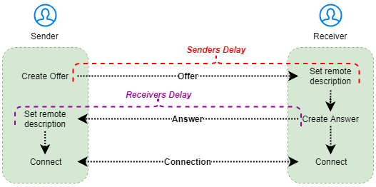
Goals
FIND:
Average lifetime of Offer/Answer
Most influential factor of the two
Average lifetime of whole exchange
Terminology

Slide 47
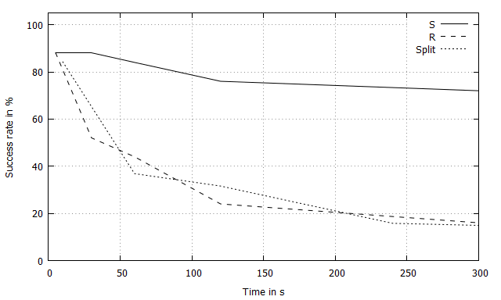
Contribution to SendIt
Which part is more time-constrained?
How usable is the serverless mode?
How to improve the serverless mode?
Result experiment 1

Slide 48
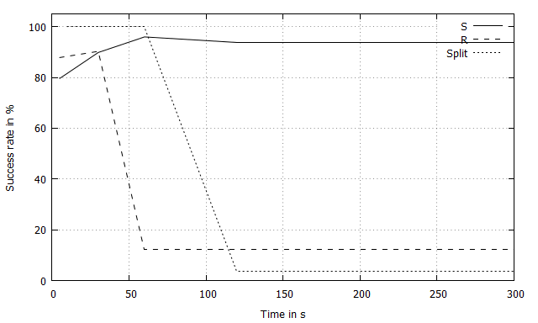
Method
Server and Client tries to establish WebRTC connection
Test with different delays when sharing offer and/or answer
Did experiment twice to verify results
Simulates user behaviour
Result experiment 2

Slide 49

Results
Both experiments gave similar results
Only relevant for Serverless mode
Offer: ~ 5 min
Answer: ~1 min
Total: ~6 minutes

